Slide 1











6TH - 7TH AUG 2026
KIGALI MARRIOTT HOTEL, RWANDA
31 AUG – 1 SEPT 2026
NOVOTEL HOTEL PERTH, WESTERN AUSTRALIA
THE CLEAN ENERGY CONFERENCE & EXHIBITION
Kigali, Rwanda.

Slide 2

Why This Conference Matters Now
Global Energy Transition Momentum
Africa's Clean Energy Renaissance
Strategic Partnership Opportunity
The COP28 commitment to triple renewable capacity by 2030 has created unprecedented global alignment. International climate finance is flowing toward developing nations, with $100 billion annually pledged for climate action. Australia has positioned itself as a renewable energy superpower, while Africa holds 60% of the world's best solar resources. This convergence of political will, financial resources, and technical expertise creates a unique window of opportunity.
Africa's energy landscape is experiencing rapid transformation. Solar costs have dropped by 85% since 2010, making renewable energy the most economical option for new capacity across the continent. Countries like Rwanda, Kenya, and South Africa are pioneering innovative energy policies and attracting significant international investment. The African Development Bank's $25 billion energy compact and the EU's Global Gateway initiative demonstrate growing international commitment.
Australia and Africa share complementary strengths that, when combined, can accelerate global clean energy deployment. Australia brings world-leading renewable energy technology, project development expertise, and access to capital markets. Africa offers abundant renewable resources, growing energy markets, and strategic minerals essential for clean energy technologies. Rwanda's leadership in good governance and sustainable development provides the perfect platform for formalizing these partnerships.
The International Energy Agency projects that achieving net-zero emissions requires $1.8 trillion in annual clean energy investment in emerging economies by 2030. Africa's share represents the largest untapped market for renewable energy deployment, making this conference essential for channeling global resources toward the continent's energy transformation.
However, coordination between African nations and international partners remains fragmented. This conference will create the structured dialogue necessary to align resources, share best practices, and develop continental energy strategies that benefit all stakeholders while accelerating deployment timelines.
The timing aligns with Australia's renewed focus on Pacific and African partnerships, as well as Rwanda's positioning as a continental convening hub following successful hosting of major international events including CHOGM 2022 and numerous AU summits.

Slide 3
Transforming Africa's Energy Future
The Clean Energy Conference Australia Africa 2026 in Kigali & Perth represents more than a gathering of stakeholders—it's the catalyst for continental transformation. When 600 million Africans still lack electricity access and the continent's energy demand is set to triple by 2030, the partnerships forged in Rwanda will determine whether Africa becomes a global clean energy leader or remains dependent on imported fossil fuels.
2026
The Year Africa's Clean Energy Future Begins
Rwanda's leadership in hosting this conference reflects our nation's commitment to Vision 2050 and our role as Africa's climate champion. The investments attracted, knowledge transferred, and partnerships established will accelerate Rwanda's renewable energy deployment while positioning our country as the regional hub for clean energy innovation and investment.
For Rwanda
For Africa
For the World
Enhanced international reputation, increased foreign investment, strengthened regional leadership, and accelerated progress toward Vision 2050 energy goals.
Coordinated continental energy strategy, increased international partnerships, accelerated renewable deployment, and improved energy access for millions.
Significant progress toward global climate goals, demonstration of South-South cooperation success, and model for international clean energy partnerships.

Slide 4
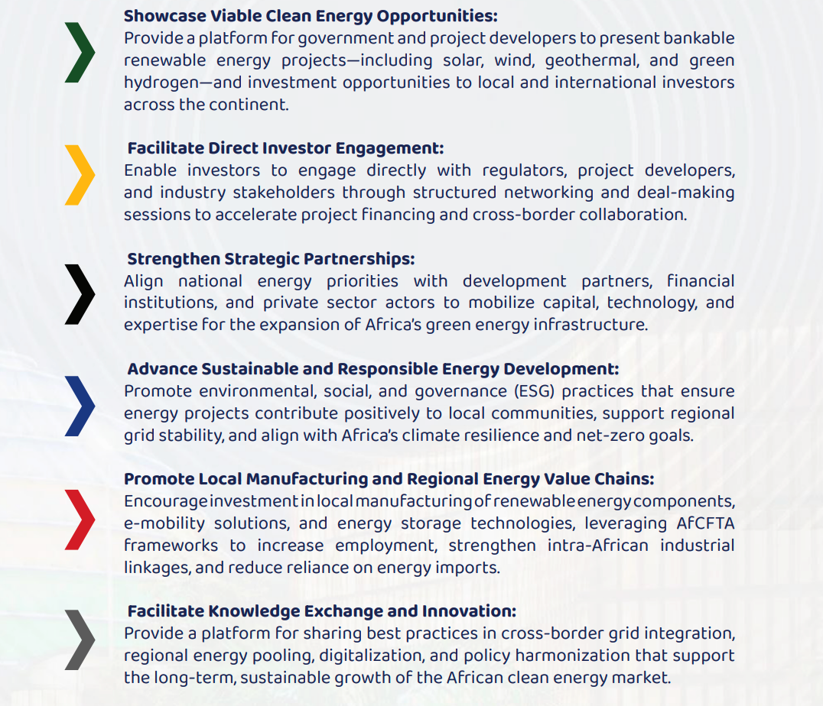
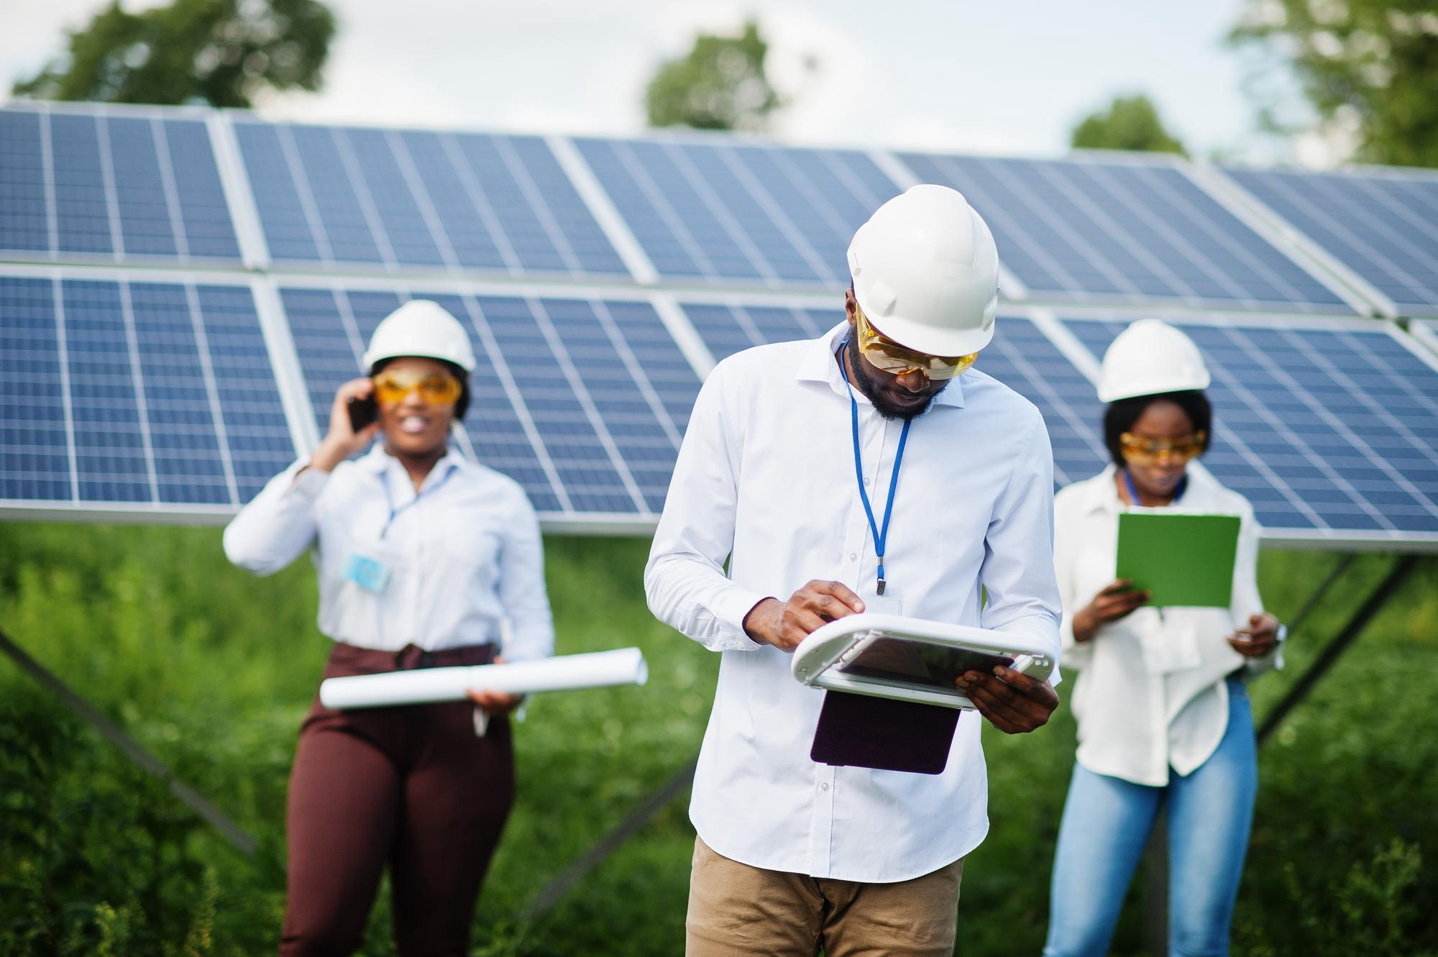
Conference Objectives

Slide 5
Global Visibility & Media Impact
International Press Coverage
Diplomatic Exposure
Digital Amplification
Strategic engagement with global energy media, including Financial Times Energy, Bloomberg New Energy Finance, and African Business Magazine, ensuring Rwanda's clean energy narrative reaches key decision-makers worldwide.
High-level diplomatic engagements with ambassadors, development partners, and multilateral organizations, positioning Rwanda as Africa's energy convenor and trusted partner for sustainable development initiatives.
Comprehensive digital strategy leveraging social media, online publications, and virtual participation options to extend the summit's reach beyond physical attendees to global audiences interested in Africa's energy future.
The summit's media strategy emphasizes Rwanda's unique position as both a successful implementer of clean energy solutions and a credible convener of continental dialogue. Through coordinated press conferences, exclusive access opportunities, and strategic storytelling, the event will generate sustained international attention that extends well beyond the summit dates.

Slide 6
Showcasing Clean Energy Success
Rwanda's remarkable clean energy achievements provide compelling evidence of what's possible when visionary leadership meets strategic implementation. The summit will serve as a comprehensive showcase of these successes, demonstrating practical solutions that other African nations can adapt to their unique contexts.
Hydropower Excellence
Off-Grid Solar Innovation
Green City Projects
Rwanda's strategic investment in hydropower infrastructure has transformed the nation's energy landscape, with facilities like Nyabarongo and Rusumo generating clean electricity while creating thousands of jobs and supporting rural development initiatives.
Pioneering off-grid solar programs have brought electricity to remote communities across Rwanda, demonstrating how innovative financing and community engagement can accelerate energy access in challenging geographical areas.
Kigali's emergence as a model green city showcases integrated urban planning that prioritizes renewable energy, sustainable transportation, and environmental protection while maintaining rapid economic growth and development.
These success stories will be presented through interactive exhibitions, site visits, and detailed case studies that provide visiting delegates with actionable insights they can implement in their own countries. The summit's showcase approach transforms Rwanda's achievements into continental resources for accelerated clean energy deployment.

Slide 7



Economic Diplomacy & Strategic Partnerships
This conference represents a sophisticated economic diplomacy initiative that leverages Rwanda's convening power to attract high-value international partnerships. By hosting ministers, ambassadors, and senior officials from across Africa and Australia, Rwanda positions itself at the center of continental energy transformation discussions while building bilateral relationships that extend beyond the energy sector.
Australia Partnership
African Union Integration
Development Finance Leverage
Deepen bilateral energy cooperation through technology transfer, capacity building programs, and joint project development. Australia's $2 billion International Climate Finance commitment provides opportunities for Rwanda to access concessional financing for renewable energy projects while Australian companies gain market entry into Africa's growing energy sector.
Strengthen Rwanda's position within AU energy initiatives, including the Continental Power System Master Plan and African Single Electricity Market. The conference provides platform for promoting Rwanda's energy expertise and securing leadership roles in continental energy governance structures while advancing regional power trading arrangements.
Engage directly with World Bank, AfDB, and other multilateral development banks to secure favorable financing terms for Rwanda's energy projects. High-level participation enables policy dialogue on innovative financing mechanisms, blended finance structures, and risk mitigation instruments that can accelerate renewable energy deployment across Rwanda and the region.
The relationships built through this conference create lasting diplomatic assets that support Rwanda's broader development objectives. Energy partnerships often evolve into broader economic cooperation encompassing trade, investment, technology transfer and knowledge exchange across multiple sectors, multiplying the conference's long-term value for Rwanda's development agenda.

Slide 8




Strategic Organizers & Partners
The summit's success depends on a carefully orchestrated partnership between leading institutions that bring complementary expertise, networks, and credibility to the initiative. This collaborative approach ensures comprehensive coverage of technical, policy, and investment dimensions while leveraging each partner's unique strengths.
AAEMI Leadership
Kenya & Australia Chamber of Commerce Partnership
The Australia Africa Energy and Mineral Institute delivers specialized training, applied research and advisory services, while convening stakeholders across energy, mining and sustainability sectors to advance skills, foster partnerships and promote practical solutions supporting Africa’s sustainable development and industrial growth.
Australia renowned energy research capabilities and international academic networks bring rigorous technical analysis, innovative solutions, and global credibility to the summit's proceedings and outcomes.
Ministry of Infrastructure
Private Sector Engagement
Rwanda's Ministry of Infrastructure provides essential local knowledge, logistical support, and policy integration that ensures the summit aligns with national priorities while showcasing Rwanda's institutional capacity.
Strategic private sector partners contribute industry expertise, investment perspectives, and practical implementation experience that bridges the gap between policy aspirations and market realities.

Slide 9
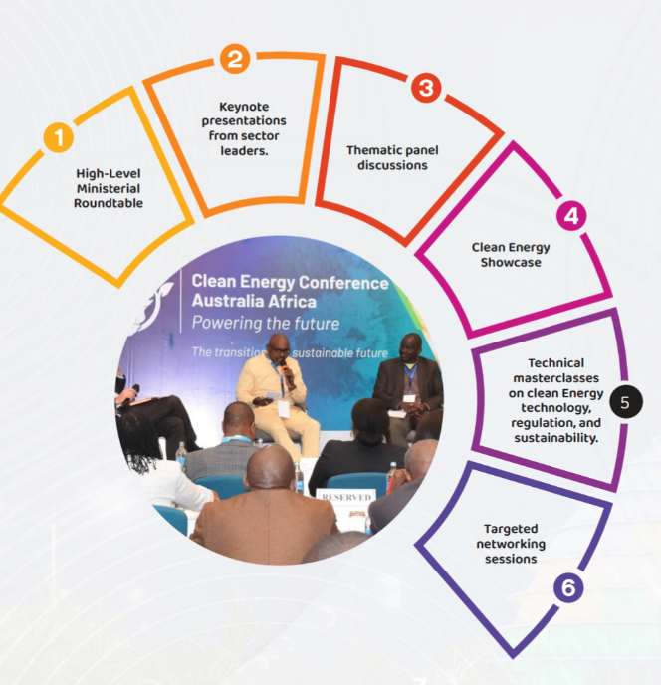
Conference Structure

Slide 10










Conference Design & Thematic Framework
Green Hydrogen Economy
Renewable Energy Technologies
Emerging hydrogen production, storage, and export opportunities. Australia's hydrogen strategy and Africa's renewable resources create synergies for continental hydrogen industry development.
Solar, wind, and hydroelectric project development, grid integration strategies and technology innovation. Focus on scalable solutions suitable for African conditions and Australian expertise in distributed energy systems.
Energy Storage Solutions
Battery technologies, pumped hydro storage, and grid stability solutions essential for high renewable energy penetration in African power systems.
Climate Finance & ESG
Mobilizing private sector investment, blended finance mechanisms and environmental, social and governance frameworks for sustainable energy development.
Climate Resilience
Building energy infrastructure resilient to climate change impacts, disaster preparedness and adaptive management strategies for renewable energy systems.
Each thematic area includes ministerial-level policy sessions, technical expert panels, private sector roundtables, and practical site visits to operational renewable energy projects in Rwanda. This multi-level engagement ensures both high-level political commitments and practical implementation pathways are developed throughout the conference.

Slide 11


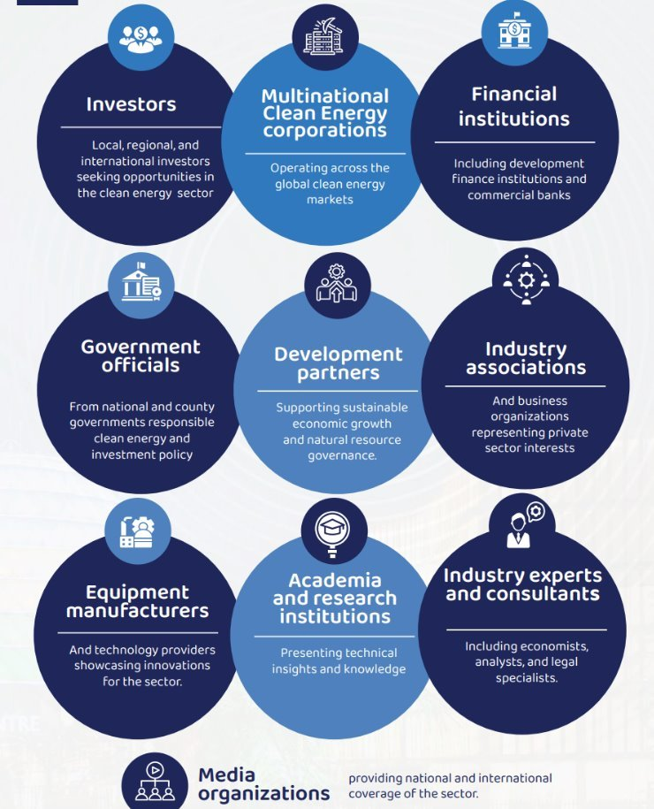




Target Audience & Reach

Slide 12
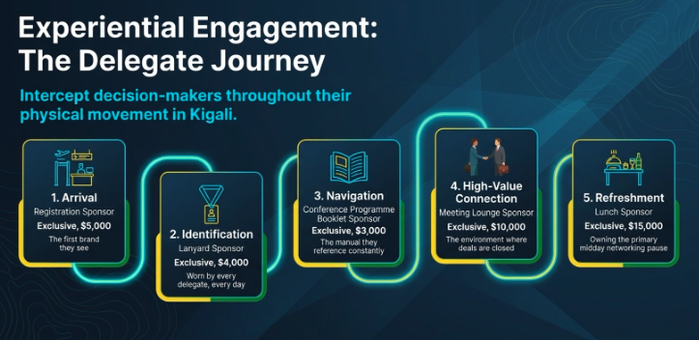

Slide 13


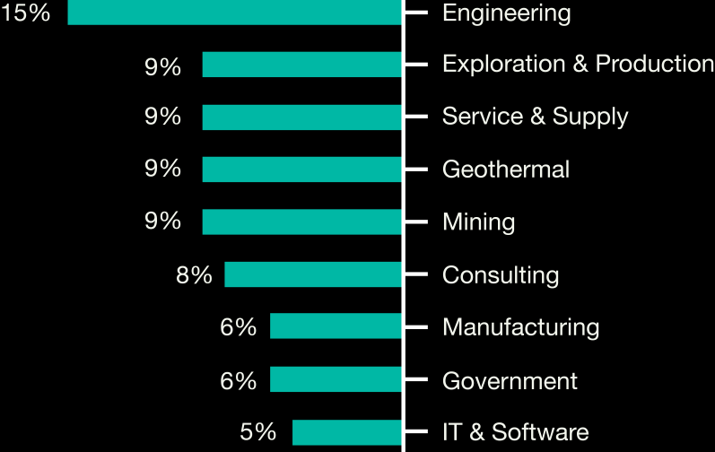
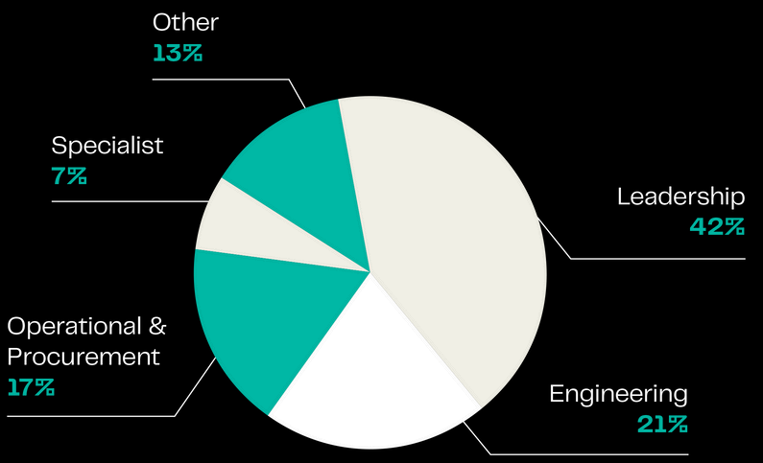

Our Audience
The Clean Energy Conference serves as Africa's leading platform for fostering connections among key stakeholders in the energy and mining sectors.
This prestigious event brings together a diverse array of participants, including policymakers, government officials, influential investors, and innovative project developers. By facilitating meaningful discussions and collaborations, the conference aims to drive progress and sustainability within these vital industries across the continent
Our Audience
Top Industry Sectors
Online Audience
The Clean Energy Conference serves as Africa's leading platform for fostering connections among key stakeholders in the energy and mining sectors.
This prestigious event brings together a
diverse array of participants, including
policymakers, government
officials, and innovative By facilitating and
influential project
investors, developers.
meaningful discussions
collaborations, the conference aims to drive progress and sustainability within these vital industries across the continent.
20, 000+
EMAIL SUBSCRIBERS
6,000+
SOCIAL MEDIA AUDIENCE
100 ,000 +
ANNUAL WEBSITE VIEWS
What our visitors think;
90% 91%
Of exhibitors consider exhibiting vital for their business to connect with industry leaders and discover innovative clean energy solutions were the main reasons for attending
Visitor Satisfaction

Slide 14
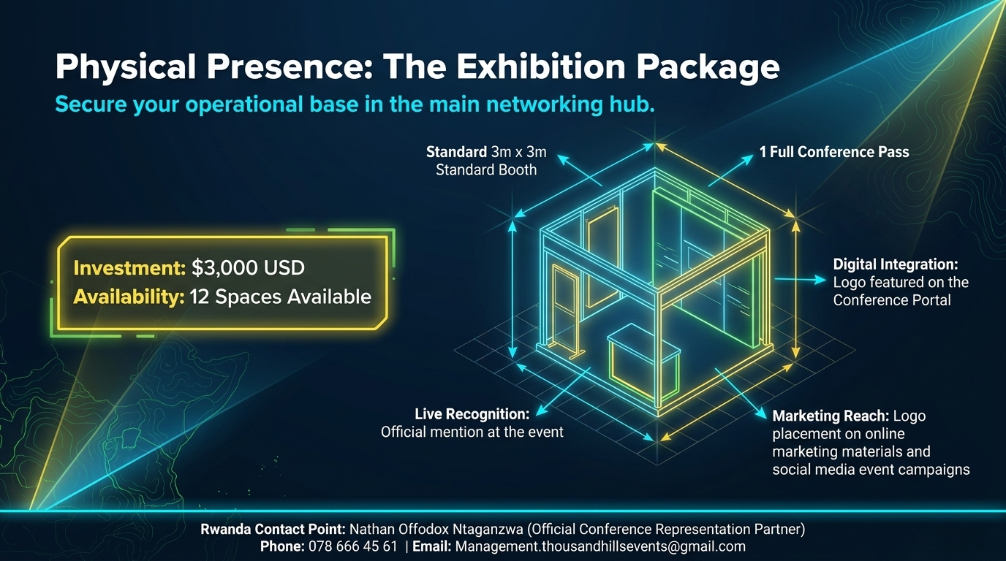

Slide 15
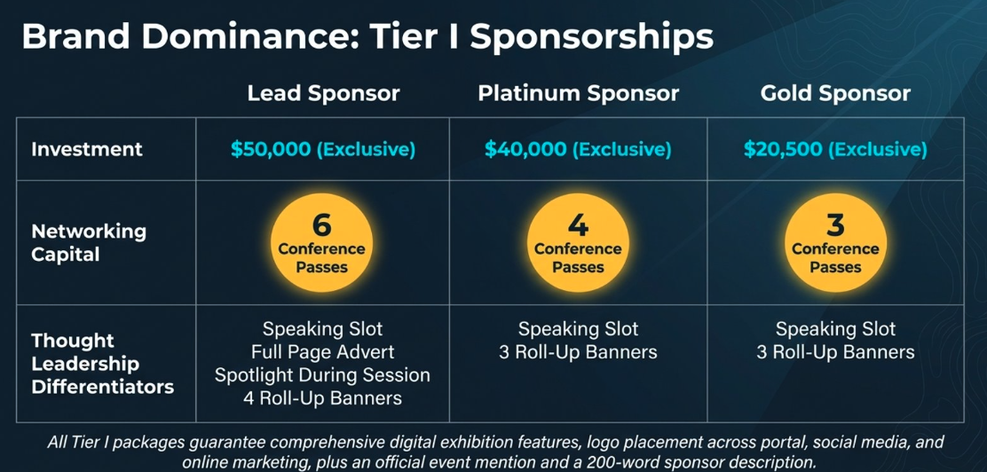

Slide 16
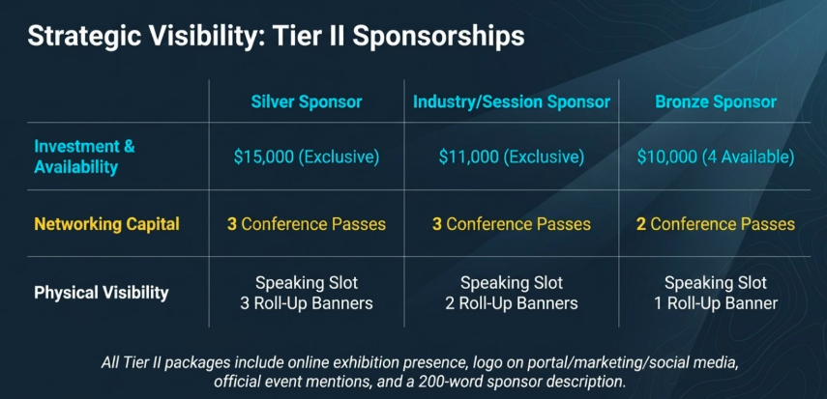

Slide 17
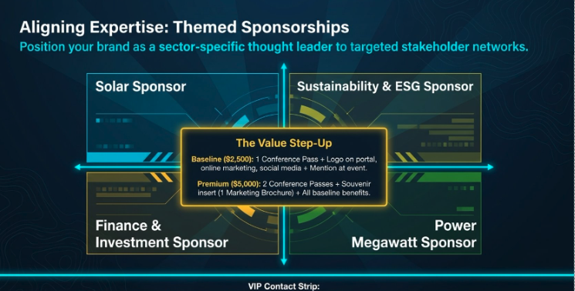
Ccc

Slide 18
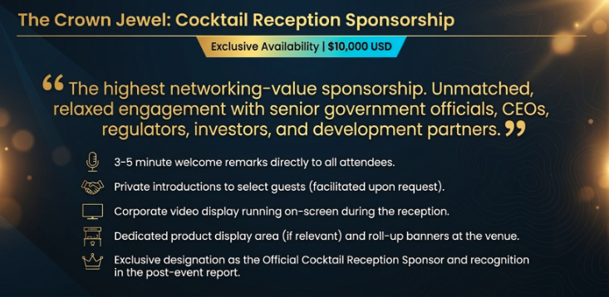

Slide 19












CONTACTS:
Clean Energy Conference Africa Australia Britam Towers, 15th Floor, Hospital Road, Upper Hill
P.O BOX 57608-00200, Nairobi,
Tel: +254 725 707 557
Email: info@cleanenergyconference.com.au Website: www.cleanenergyconference.com.au
www.cleanenergyconference.com.au

